Slide 1
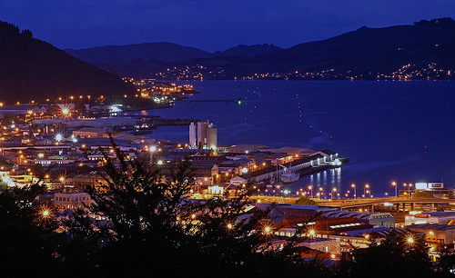
Dunedin Nights
An online presence developed by Joel Pickworth and Blair Hayes for the Otago University Students Association

Slide 2
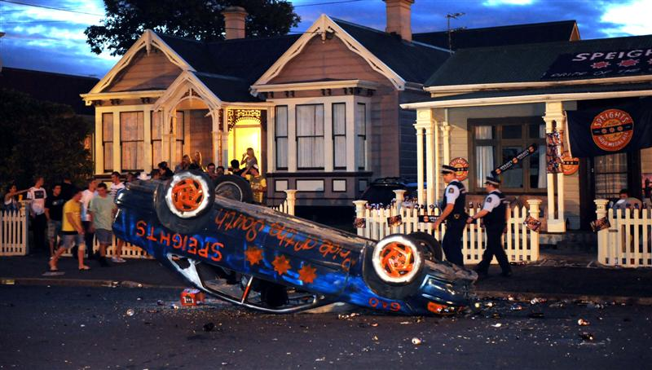
Why do we need this website?

Slide 3
Potential Content:
Our content will include:
Updated list of events.
Information on bars and “safer party areas.”
Student input.
Links to specialised help.

Slide 4
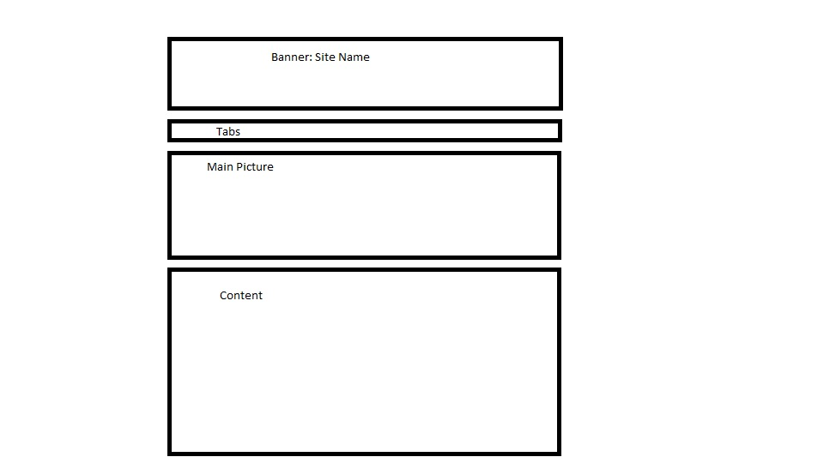
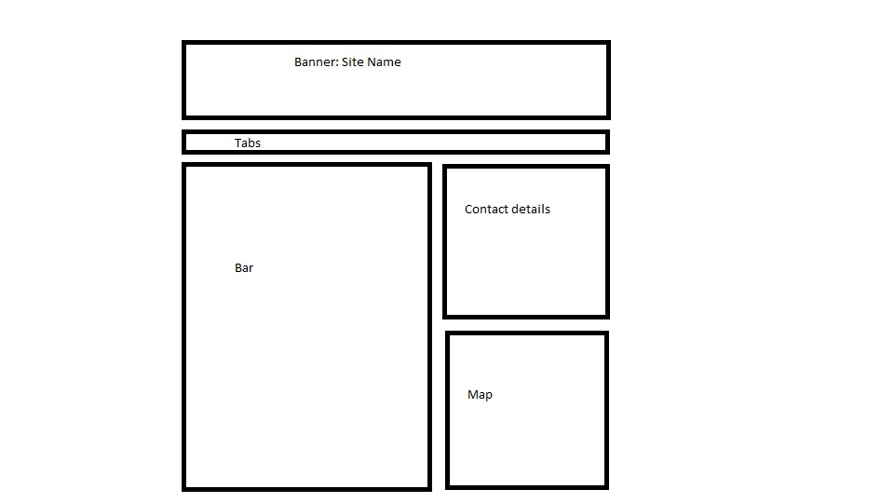
Initial Layout Plan:
Home Page: Bar Information:

Slide 5
Site Theme:
Good flow between:
Information accessibility.
Social opinions.
Event media.

